Slide 1
Unit 2: Trigonometry
Jeronimo Campos
Period 1

Slide 2
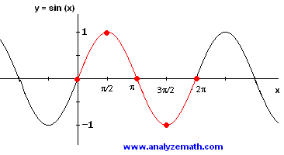
Graphing Sine Function
F(x)= sin x
Domain: All reals
Range: [-1,1]
Continuous
Alternately increasing and decreasing in periodic waves
Symmetric w/ respect to the origin
Bounded
Absolute maximum 1
Absolute minimum -1
No horizontal asymptotes
No vertical asymptotes
End behavior: don’t exist
lim sin x and lim sin x
x→-∞ x→∞
The sine function has this up-down curve that occurs every 2π or 360 degrees. It starts in the origin which is (0,0) then it goes up to 1 which is at π/2. After it goes down to π then down to 3π/2 and 2π. The highest it goes is 1 and lowest is -1 because that’s the range of the sine wave graph.

Slide 3
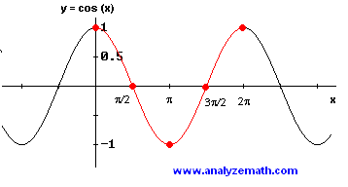
Graphing Cosine Function
F(x)= sin x
Domain: All reals
Range: [-1,1]
Continuous
Alternately increasing and decreasing in periodic waves
Symmetric w/ respect to y axis (even)
Bounded
Absolute maximum 1
Absolute minimum -1
No horizontal asymptotes
No vertical asymptotes
End behavior: don’t exist
lim cos x and lim cos x
x→-∞ x→∞
The cosine function it has an up-down curve just like the sine wave. Like the sine wave, cosine starts at 1 and goes all the way down to one when it hits π. Then it goes all the way to its starts point which in this case 1. The cycle keeps repeating. The highest point for cosine is the same as the sine wave which is 1 and lowest is -1.

Slide 4
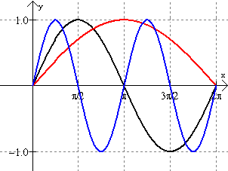
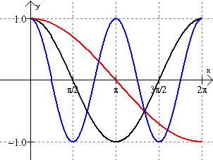
Examples of Sine and Cosine Graphs
Sine:
Cosine:

Slide 5
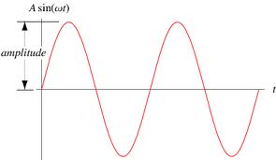
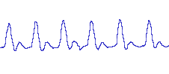
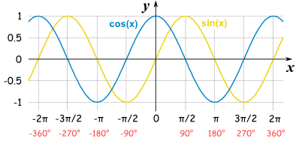
Properties: Amplitude, Frequency, Period and Phase Shift
Amplitude= |a|
Period= 2π/|b|
Frequency= |b|/2π
When compared to graphs of y=a sin bx and y=a cos bx, rspectively, they also have the following characteristics:
a phase shift of h;
a vertical translation of k
The amplitude is the height. The period of a wave is calculated by 2π/|b|. The period is when the wave completes one whole cycle. The frequency is just the reciprocal of a period. The frequency is how fast it’s going.

Slide 6
Inverse of Trigonometric Functions
Inverse of Sine:
Interval [-π/2,π/2] such that sin y=x is the inverse sine or arcsine.
Denoted sin^-1x or arcsin x
Domain: sin ⁻¹ x is [-1,1]
Range: [-π/2,π/2]
Inverse of Cosine:
Interval [0,π] such that cos y=x is the inverse cosine or arccosine
Denoted cos⁻¹ x or arcos x
Domain: y=cos^-1 x is [-1,1]
Range: [0,π]
Inverse of Tangent :
Interval [-π/2,π/2] such that tan y=x is the inverse tangent or arctangent.
Denoted tan^-1x or arcsin x
Domain: tan⁻¹ x is [-∞,∞]
Range: [-π/2,π/2]
Ex #1
Ex #2

Slide 7
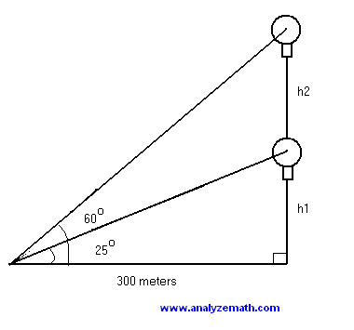
Application Problems
Problem:
The angle of elevation of a hot air balloon, climbing vertically, changes from 25 degrees at 10:00 am to 60 degrees at 10:02 am. The point of observation of the angle of elevation is situated 300 meters away from the take off point. What is the upward speed, assumed constant, of the balloon? Give the answer in meters per second and round to two decimal places.
Use the tangent to write tan(25º) = h1 / 300 and tan(60º) = (h1 + h2) / 300
Solve for h1 and h2 h1 = 300 tan(tan(25º)) and h1 + h2 = 300 tan(60º)
Use the last two equations to find h2 h2 = 300 [ tan(60º) - tan(25º) ]
If it takes the balloon 2 minutes (10:00 to 10:02) to climb h2, the upward speed S is given by S = h2 / 2 minutes = 300 [ tan(60º) - tan(25º) ] / (2 * 60) = 3.16 m/sec

